Slide 1
Web Application
Using Django
Part III

Slide 2
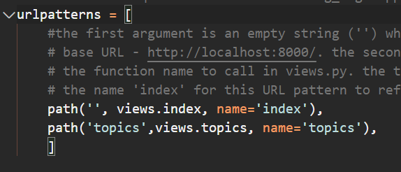
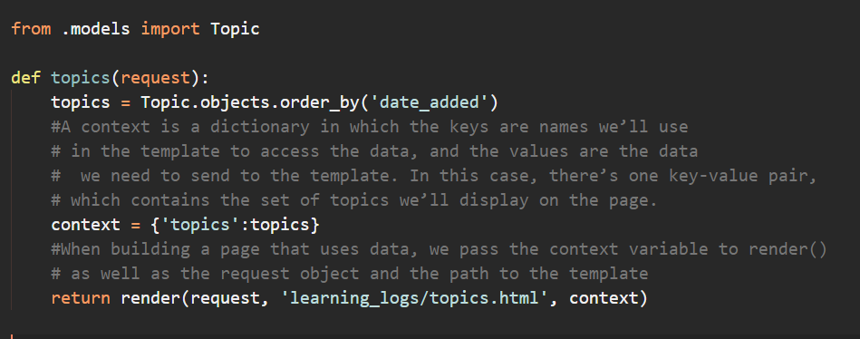
The Topics Page
urls.py
views.py

Slide 3
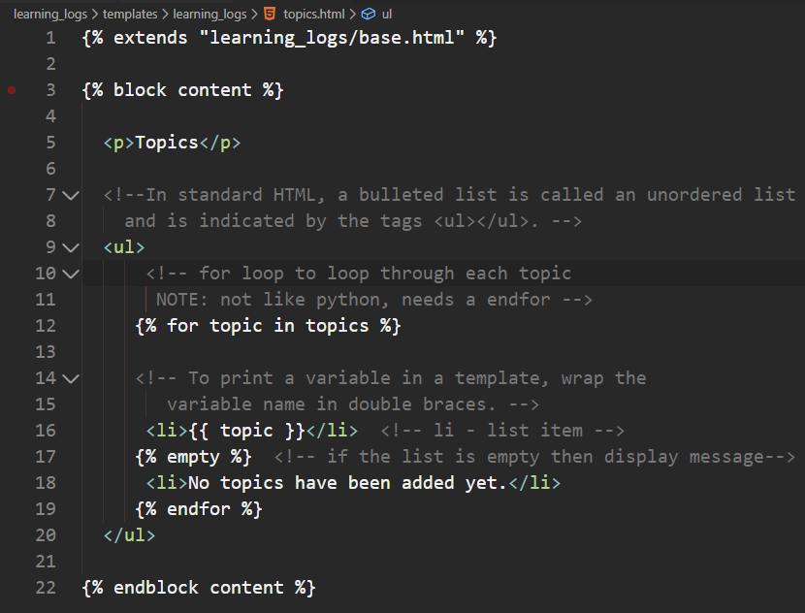
The Topics Page
topics.html

Slide 4
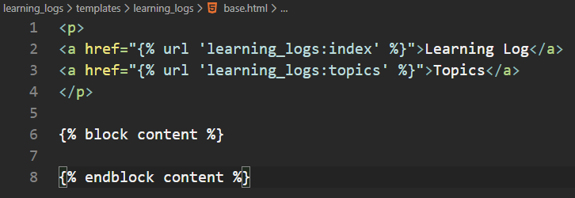
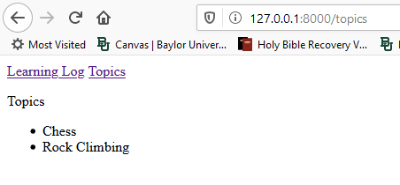
The Topics Page
base.html
modify the base template file to include a link to the topics page

Slide 5
Individual Topic Pages
create a page that can focus on a single topic, showing the topic name and all the entries for that topic
define a new URL pattern
write a view
create a template
modify the topics page so each item in the bulleted list links to its corresponding topic page

Slide 6
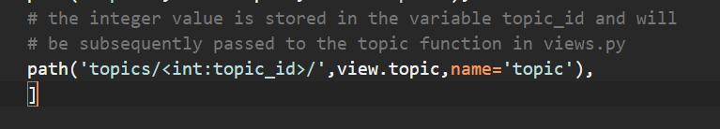
The Topic URL Pattern
The URL for each individual topic is different than what we have done so far.
Each topic has an individual ID which is how it is identified
The ID has to be incorporated into the URL to be able to display the data for that topic

Slide 7
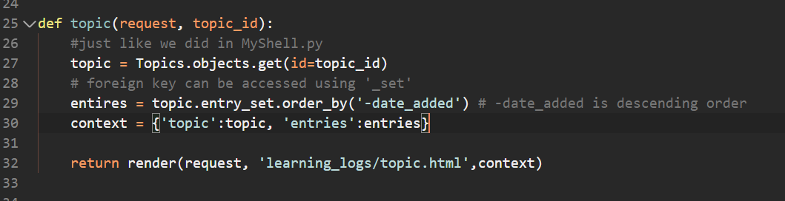
The Topic View
The Topic function needs to get the topic and all associated entries from the database

Slide 8
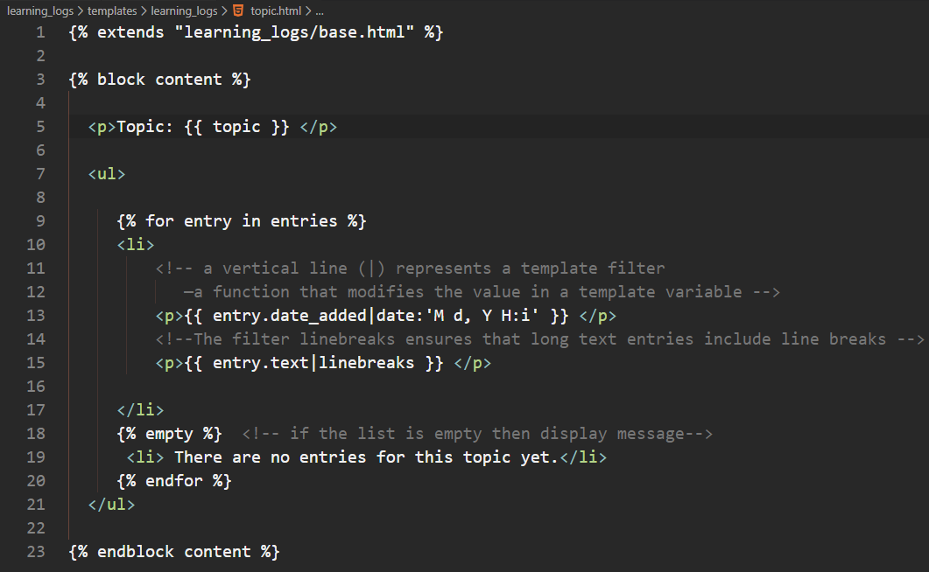
The Topic Template
The template needs to display the name of the topic and the entries

Slide 9
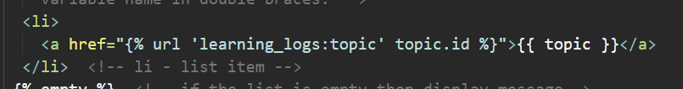
Modify the Topics Template
modify the topics template so that each topic listed is a link to the topic page
NOTE: topic.id is different from topic_id. Since Topic is an object that is passed through context, the attributes are accessible, in this case id
It is necessary to get id since that is how we can build a specific page in the corresponding template file (see urls.py)

